Slide 1
Quantum Error Correction
Philippe Noël, Alaisha Sharma, Nicolas Weninger
ES 170 Final Project
10 May 2018

Slide 2
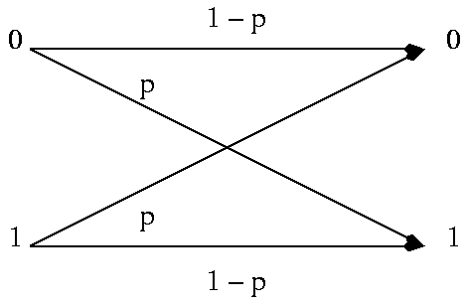
Basis in classical error correction
General idea
Message = bit sequence
Encode a message with some redundancy
Some of the message may be corrupted
Enough redundancy that original message is recoverable
Binary symmetric channel
0 → 000
1 → 111
Because error probability p is small, only single bit likely to be flipped

Slide 3
Challenges with quantum error correction
No cloning states
Errors are continuous
Measurement destroys information
Notes:
No cloning states
Repetition codes work for classical bits
Qubits cannot be replicated (would require looking at superposition)
Errors are continuous
Only bit flips can occur on classical bits
Continuum of different errors can occur on qubits (for example, rotating state by any amount)
Cannot determine exactly what error occurred (would require infinite resources)
Measurement destroys information
Can observe classical output before applying correction
Cannot observe (measure) quantum data without collapsing state

Slide 4
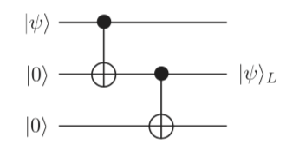

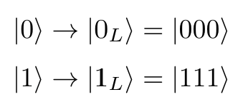
Encoding a logical qubit as 3 qubits
Single “logical” qubit mapped to three qubits
Quantum state is preserved (alpha and beta still unknown)
Redundancy introduced via duplication not repetition

Slide 5
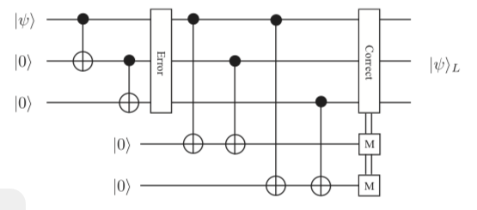
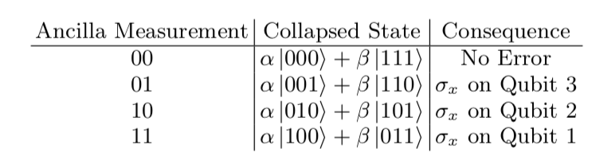
3-qubit error detection for bit flips

Slide 6
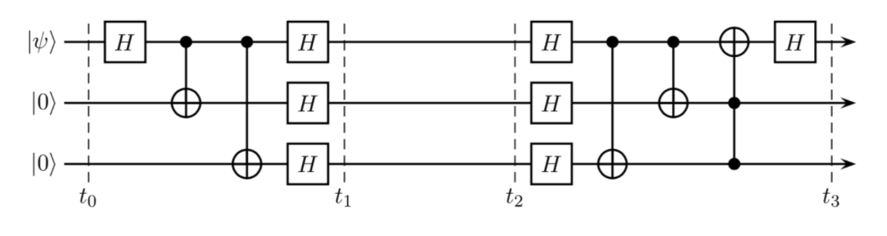
3-qubit error detection for phase flips

Slide 7
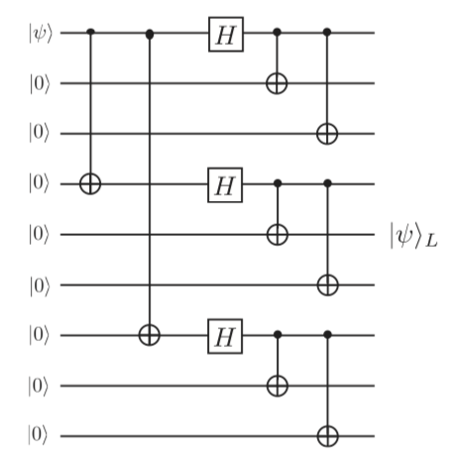
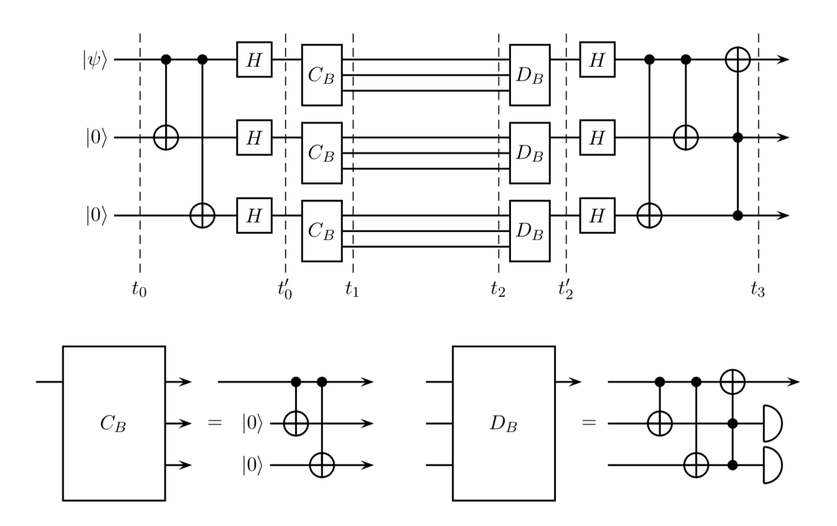
Encoding a logical qubit as 9 qubits

Slide 8
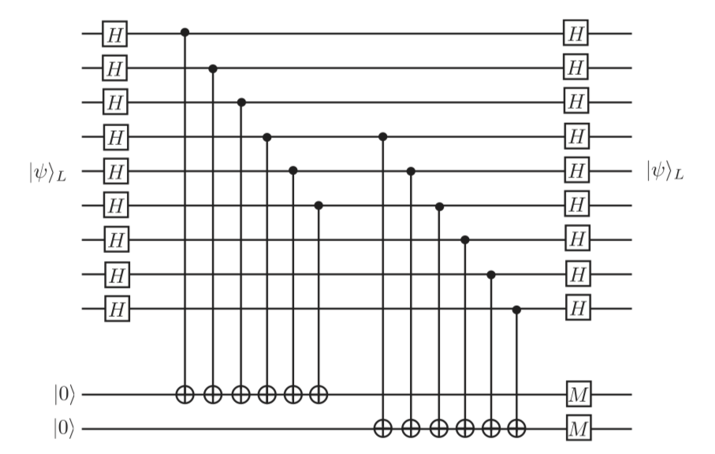
9-qubit error detection using ancilla qubits

Slide 9
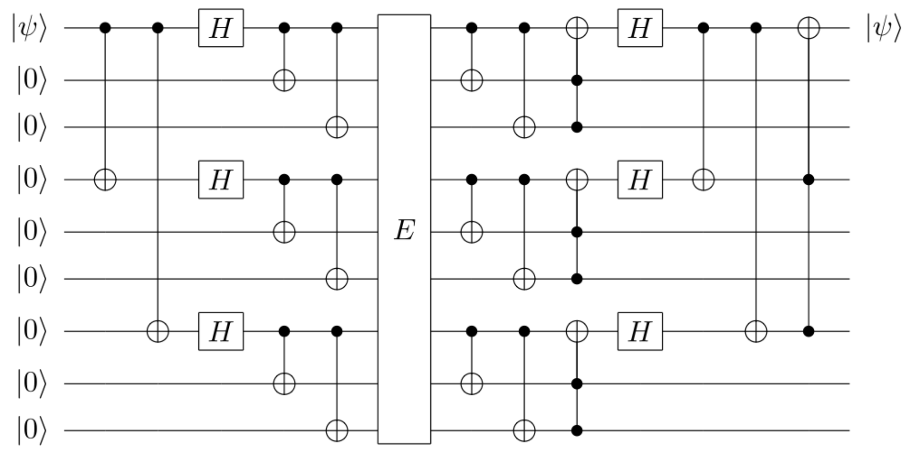
9-qubit error detection without ancilla qubits

Slide 10
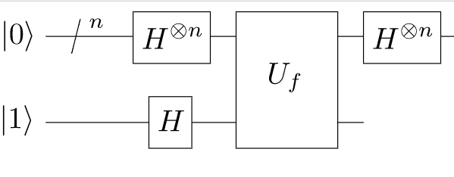
Error correction applied to Deutsch-Josza

Slide 11
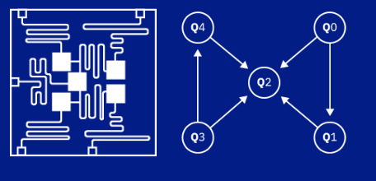
Quantum computing architecture

Slide 12
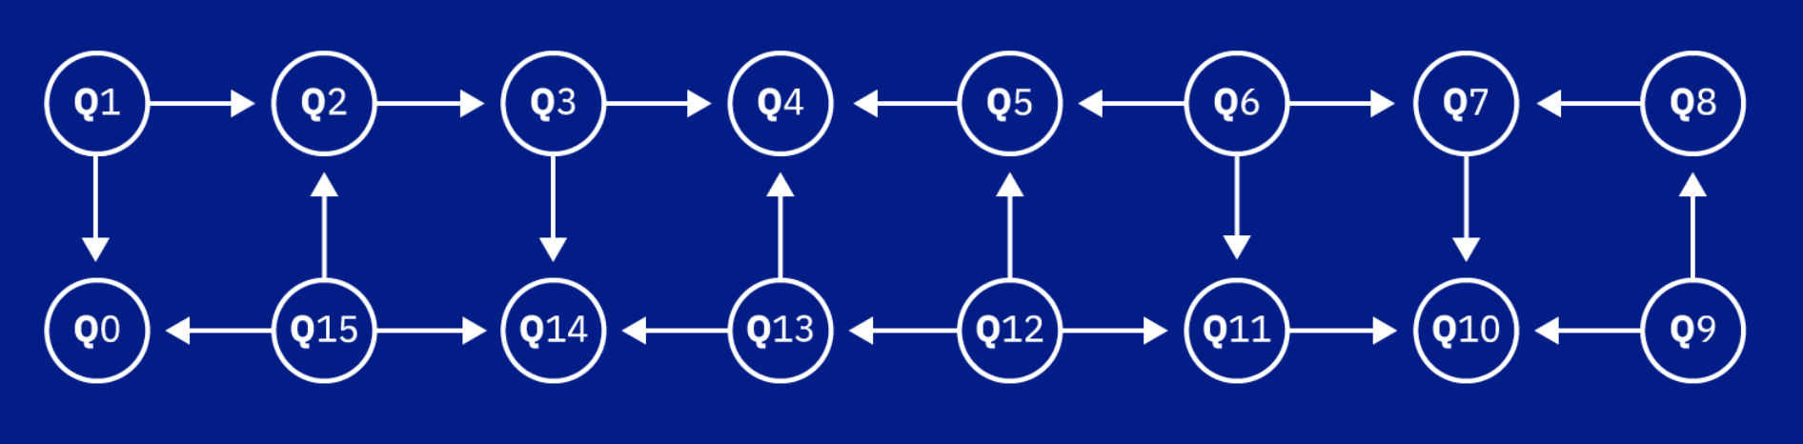
Quantum computing architecture

Slide 13
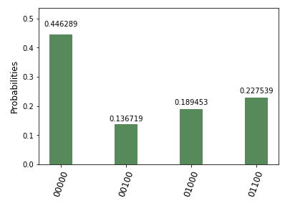
Modern error correction schemes
Assumptions
Perfect gate fidelity
Specific error-prone channel location
Only bit flip (X) and phase flip (Z) errors
Example: 3-qubit control circuit to detect bit flip (no errors introduced) run on IBMQ.
expected state
quantum “noise”

Slide 14
Modern error correction schemes
Solution: Stabiliser Codes!
σ_{z} |0⟩ = |0⟩
Generalisable to topological error correction codes in 2D

Slide 15
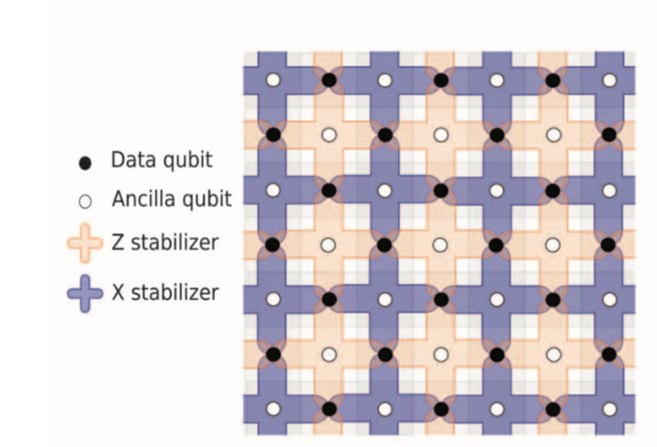
Surface code for bit and phase flips

Slide 16
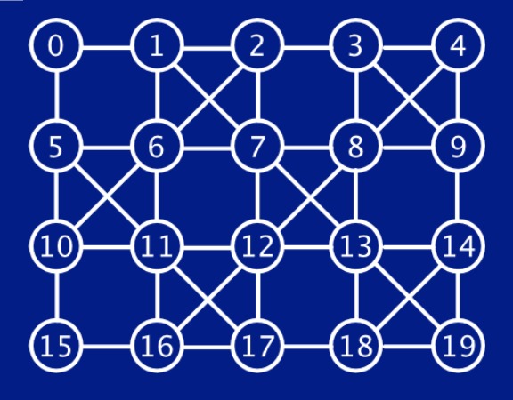
Looking Ahead

Slide 17
Thank you ES 170!

